Slide 1
Midterm Project
Performance of explainer in different text classification models
Zexin Ren
March 22, 2022
. . . . . . . . . . . . . . . . . . . .
. . . . . . . . . . . . . . . . . . . .
Zexin Ren Midterm Project March 22, 2022 1/9

Slide 2
Outline
1 Introduction
Explainer
Model and Dataset
2 Analysis Method
Salience Analysis
Top K Features Mask
3 Result
Accuracy Tendency
. . . . . . . . . . . . . . . . . . . .
. . . . . . . . . . . . . . . . . . . .
Zexin Ren Midterm Project March 22, 2022 2/9

Slide 3
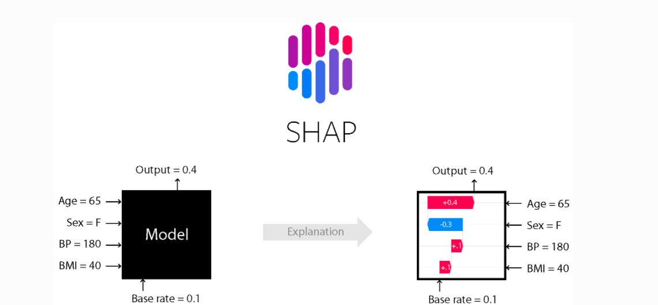

Introduction
Explainer
”Why Should I Trust You?”: Explaining the Predictions of Any Classifier
Figure: An example of SHAP explainer
. . . . . . . . . . . . . . . . . . . .
. . . . . . . . . . . . . . . . . . . .
Zexin Ren Midterm Project March 22, 2022 3/9

Slide 4
Introduction
Model and Dataset
 | Model 1 | Model 2
Num. of Labels | 2 | 5
Model Name | distilbert-base-uncased | distilbert-base-uncased
Tokenizer Name | distilbert-base-uncased | distilbert-base-uncased
Dataset | Clinical Statement | Medical abstracts
Test Accuracy | 85 . 5 % | 77 %
. . . . . . . . . . . . . . . . . . . .
. . . . . . . . . . . . . . . . . . . .
Zexin Ren Midterm Project March 22, 2022 4/9

Slide 5
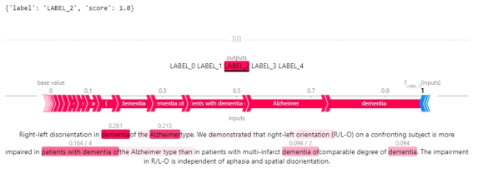
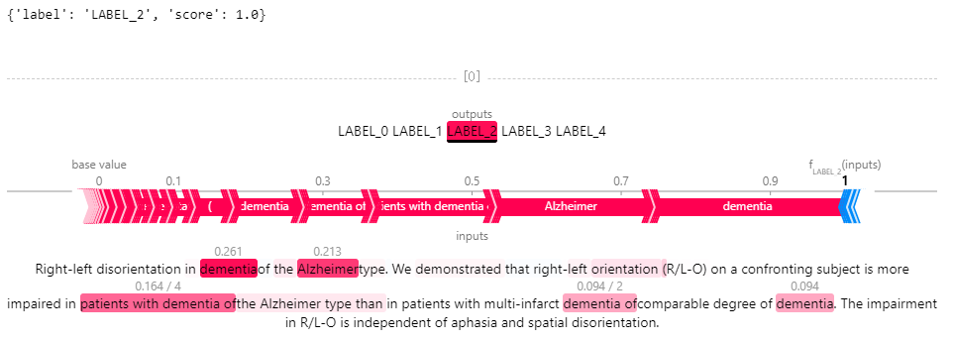
Method
Salience Analysis
Figure: A Text Example
. . . . . . . . . . . . . . . . . . . .
. . . . . . . . . . . . . . . . . . . .
Zexin Ren Midterm Project March 22, 2022 5/9

Slide 6
Method
Top K Mask
How to test this result?
Figure: Top K masked
Repeat the same process to all sample on the test set, to see if the
accuracy will decrease.
. . . . . . . . . . . . . . . . . . . .
. . . . . . . . . . . . . . . . . . . .
Zexin Ren Midterm Project March 22, 2022 6/9

Slide 7
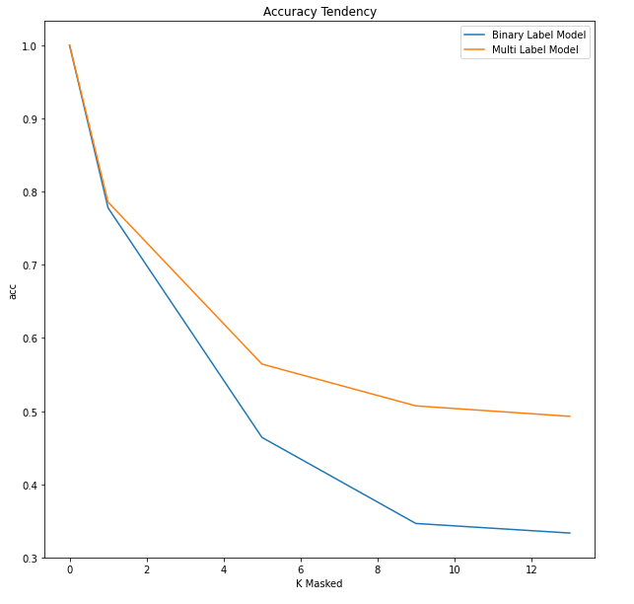
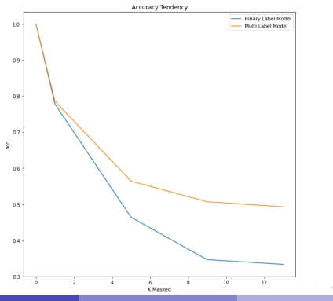
Result
Accuracy Tendency
. . . . . . . . . . . . . . . . . . . .
. . . . . . . . . . . . . . . . . . . .
Zexin Ren Midterm Project March 22, 2022 7/9

Slide 8
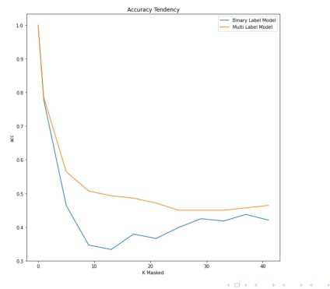
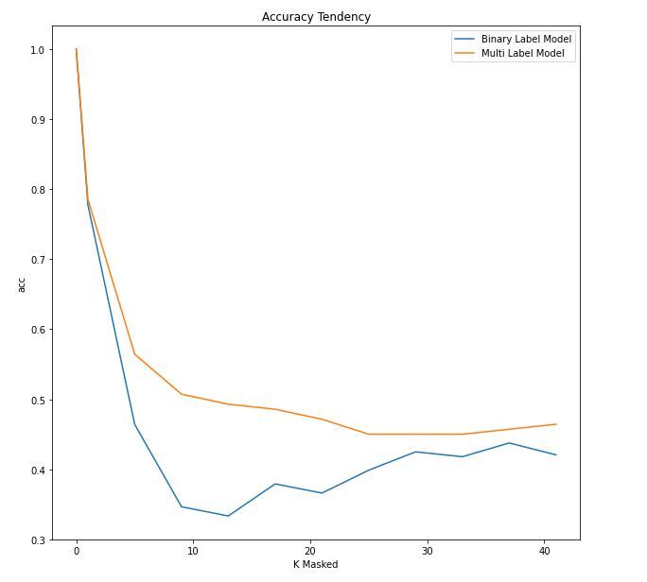
Result
Accuracy Tendency
. . . . . . . . . . . . . . . . . . . .
. . . . . . . . . . . . . . . . . . . .
Zexin Ren Midterm Project March 22, 2022 8/9

Slide 9
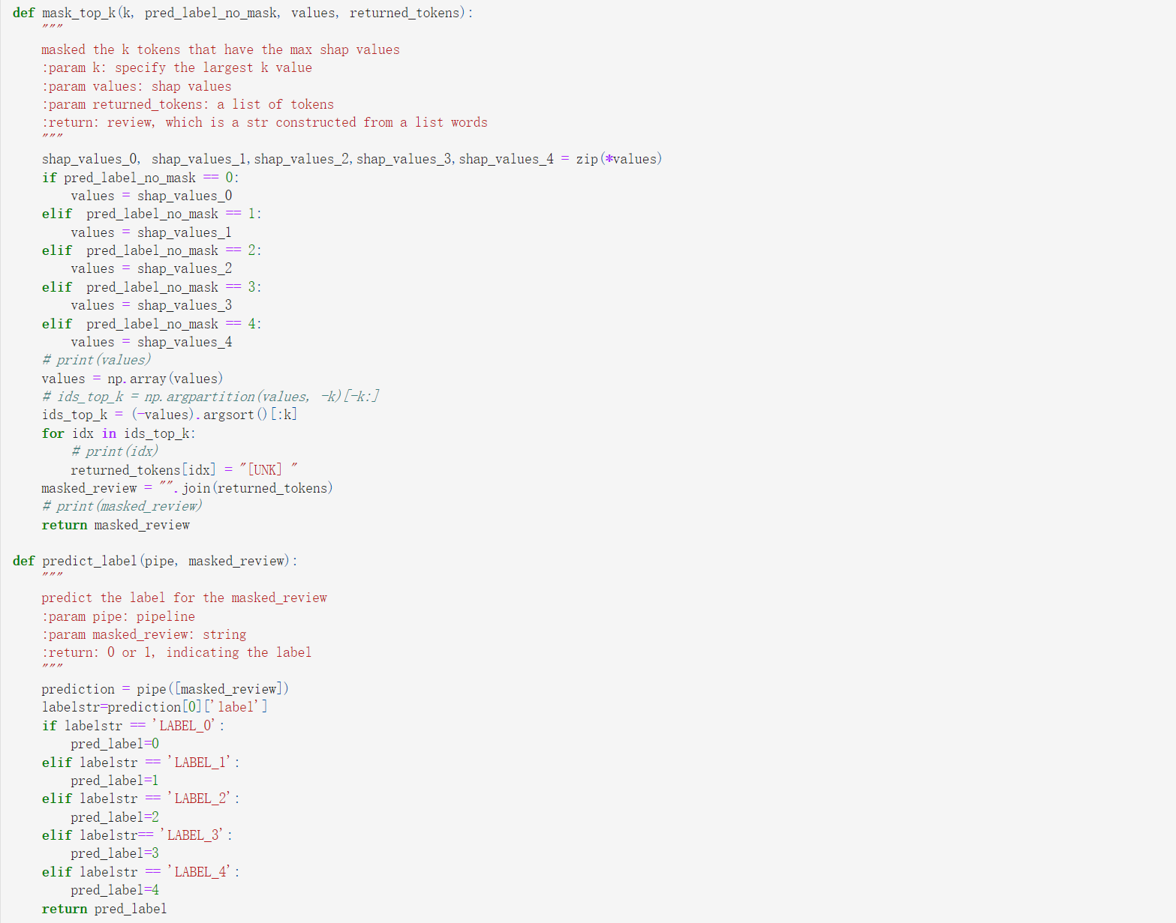
Code
Github Link:
https : //github.com/RmmLeo/STAT6289homework/tree/main/Midterm%20Project
. . . . . . . . . . . . . . . . . . . .
. . . . . . . . . . . . . . . . . . . .
Zexin Ren Midterm Project March 22, 2022 9/9

Slide 10
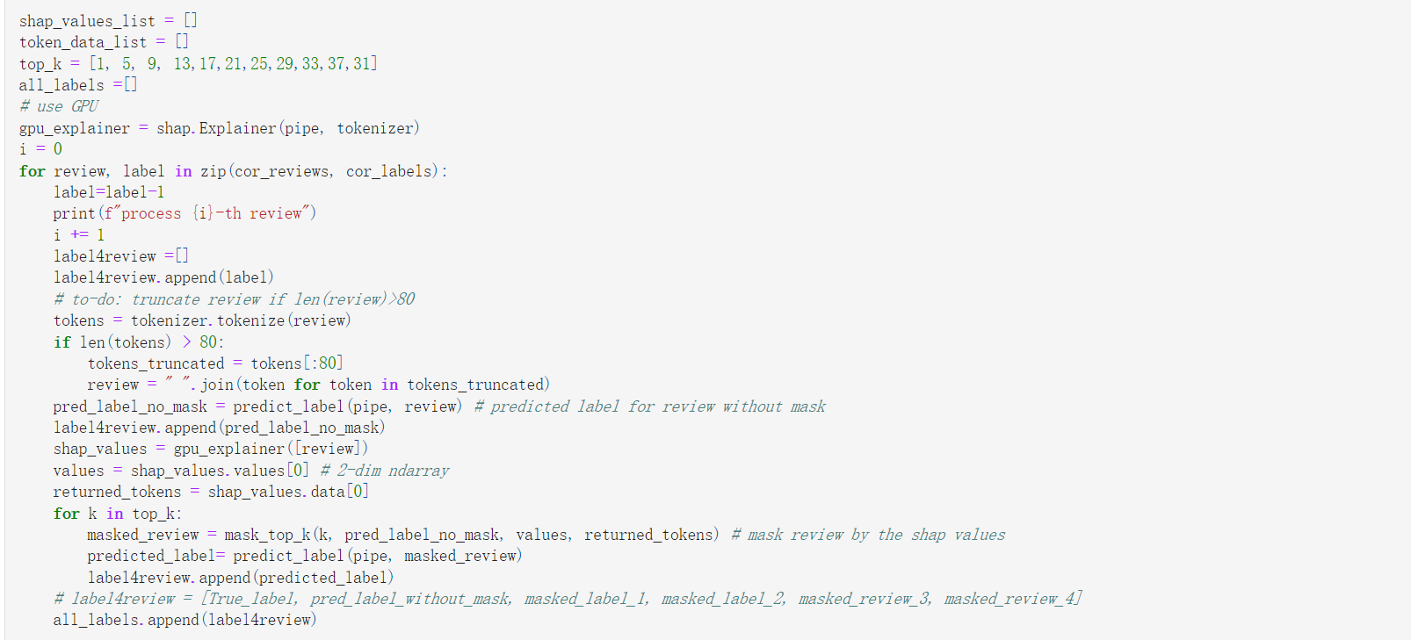
Code
Github Link:
https : //github.com/RmmLeo/STAT6289homework/tree/main/Midterm%20Project
. . . . . . . . . . . . . . . . . . . .
. . . . . . . . . . . . . . . . . . . .
Zexin Ren Midterm Project March 22, 2022 9/9

